Slide 1
SSM ppt newsletter
Volume 3
Issue 3
Oct. 29-Nov. 4, 2012
By: rayraynicki
Notes:
I JUST started making ppts for the site cuz If anybody isn’t able to be online for some reason. They can get a week’s worth of offline by printing these out and keeping them if you like. Thanks for reading. If you ever get online check out our fan site: http://shesomindless.weebly.com

Slide 2
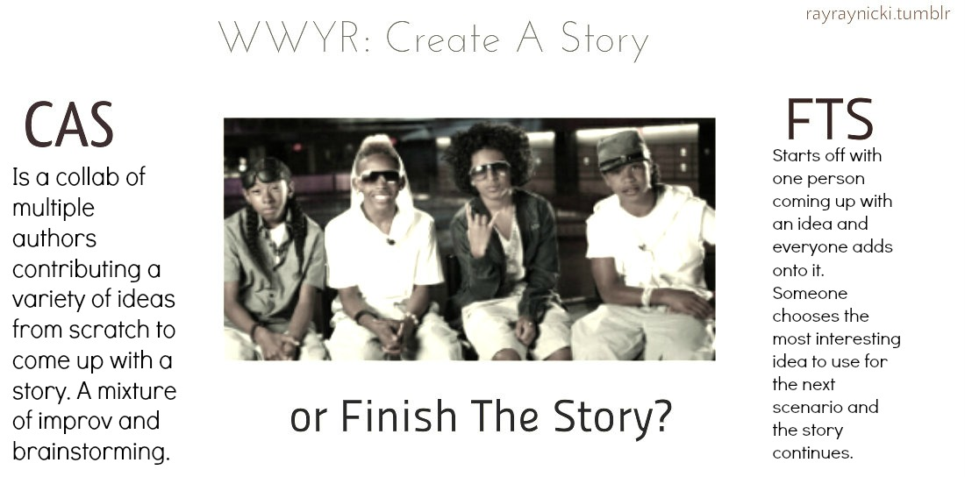
Oct. 29
Helpful links for writing fan fic stories:
http://www.plotbot.com/ (screenplay writing)
http://www.creative-writing-now.com/
Create a Story/Imagine and more ideas
http://www.eduplace.com/tales/ (fill in the blank stories)

Slide 3
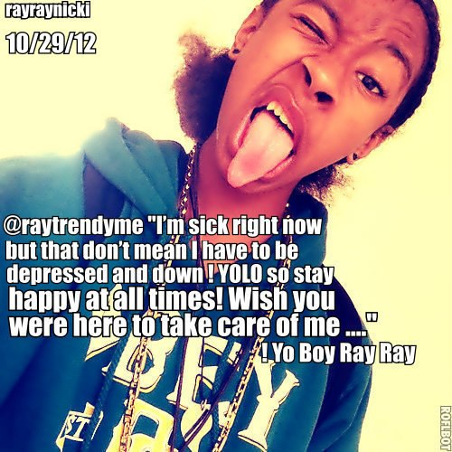
Oct. 29

Slide 4
What’s New on SSM?
Oct. 29, 2012 new tabs added to the site
MB Tweets: http://shesomindless.weebly.com/mb-tweetz.html
Oct. 30, 2012 new tabs added to the site
More MB Tweets: http://shesomindless.weebly.com/more-mb-tweetz.html
Nov. 4, 2012 new tabs added to the site
FAQ: http://shesomindless.weebly.com/faq.html

Slide 5
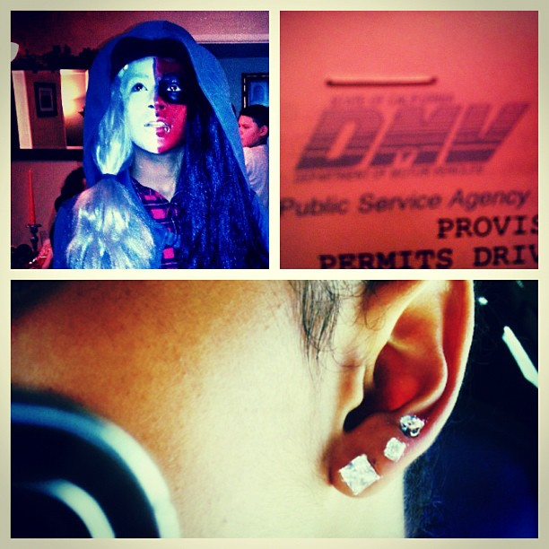
Oct. 30- 31
Oct. 31
Oct. 30
mindlessbhavior ”BEST Halloween everPassed my permit test, Got my 6th piercing,And my Halloween outfit was!! UM... Yea”-Princeton
Mindless Behavior✔
@MindlessBhavior
who's going 2 or has already been to @UniStudios for@HorrorNights? #universalhhn
Mindless Behavior✔
@MindlessBhavior30 Oct 12
#TEAMMINDLESS: The Atom Factory team just launched a new drink called @POPwater! Follow back and check it out!
Mindless Promoter ™@rayraynicki
@MindlessBhavior @POPwater awesome advertising with the display of the fruit in the water!

Slide 6
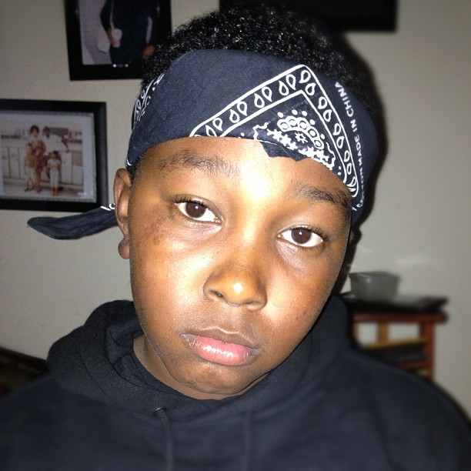
Oct. 31
mindlessbhavior happy halloween!! *evil laugh*
mindlessbhavior @spiffyday my little bro bout to hit Universal Studios with me ....... Looking like Kendrick Lamar lol Yo Boy Ray Ray

Slide 7
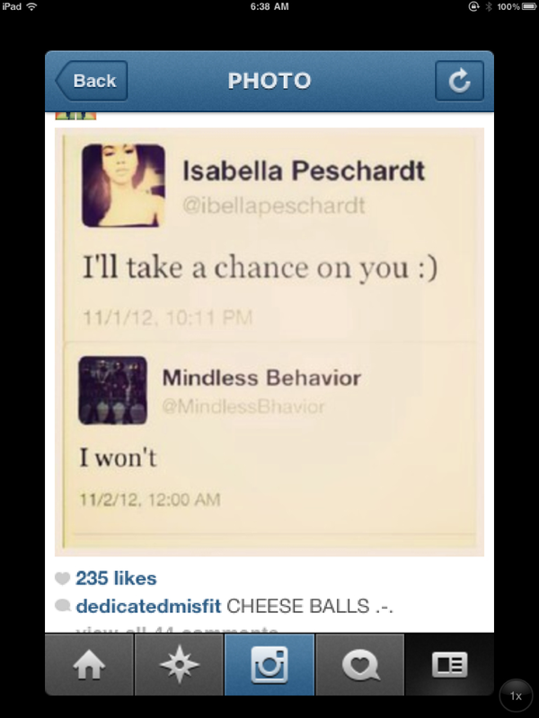
Nov. 1
Bella got swerved by Princeton on IG

Slide 8
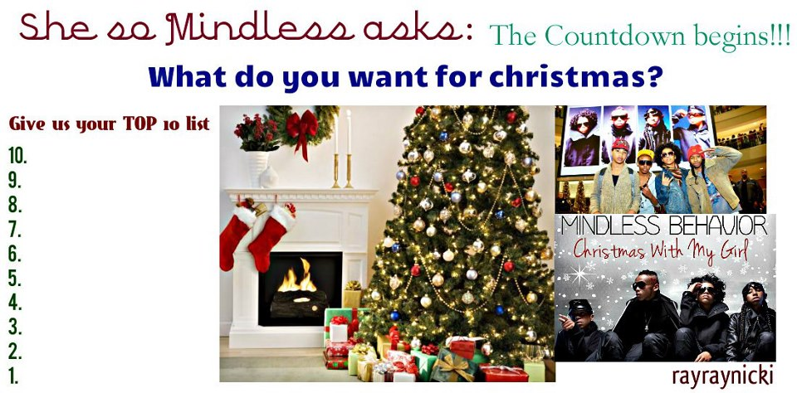
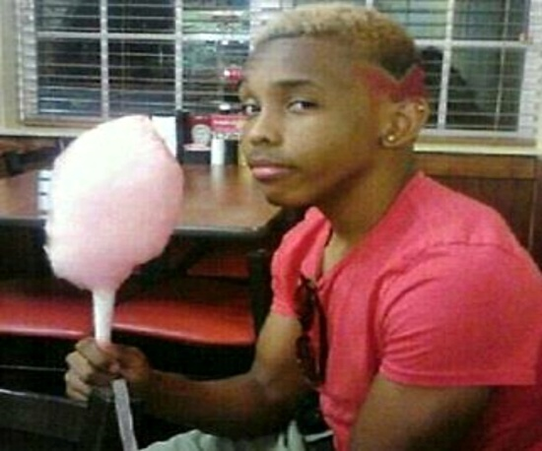
Upcoming submissions
There are two submissions that are currently on deadline for.
Christmas wish list 2012 (deadline ends mon. Dec. 24, 2012)
Happy Birthday Prodigy (deadline ends weds. Dec. 26, 2012)
Christmas Wish list: (send us your top 10 list of items, ppl 2 see or want 2 do for Christmas) See this link for more info: http://shesomindless.weebly.com/christmas-wishlist-2012.html
Want to say Happy Birthday to MB? Show your love by sending us pix and vids!!!
To say Happy Bday to Prodigy go here: http://shesomindless.weebly.com/happy-birthday-prodigy.html

Slide 9
Other Submissions
FAQ submissions: Got any q's about the site?
Do you own or co-own your own mb fan site?
Birthday Shoutouts: Want to get a special bday banner for your bday? Would you like it to be displayed on the site?
Do you make your own memes? Share them with us
Do you make awesome pic edits and you want to share them so that they maybe displayed on ssm?
Do you know any typical sayings from team mindless and want to share them with us?
What makes YOU mindless?
Why do you love prod, ray, prince and/or roc?
WWYD/WWYR: Do you come up with good mb q's?

Slide 10
More Submissions
Imagines: Do you LOVE writing imagines?
Want to share your #1 Girl Tour Experience on SSM?
Mindless Dreams: (real dreams that you have of mb or is mb-related)
Your answers to my MB q’s on the site
Do you own or know of any good tm hangout sites?
Do you write poems about MB? Want to share them?
Do you write MB fan fic stories? Submit your links and give us a brief description of your story.

Slide 11
Want to submit stuff to SSM?
Submission requirements are:
email me at shesomindless143@yahoo.com 1. Must include one of the following: your name, your screen name or remain anonymous 2. The subject of your email message should be: THE TITLE OF YOUR SUBMISSION SHOULD BE IN CAPITAL LETTERS 3. If you have any pictures to send us then you may submit them as attachments 4. If you made a video and want to share it via YouTube then you can either email me the video or share the link for it.
It can be either be on the fan site, the newsletter or both! ☺

